Slide 1


Front Page
Simple Activity
Workout
My page

Slide 2
My Page - Main
My page
Welcome to your page. Here you can get an overview over your latest workouts, which muscle groups you have been working on and recomendations for a workout schedule.
Overview
Muscle groups
Schedule
My workouts

Slide 3

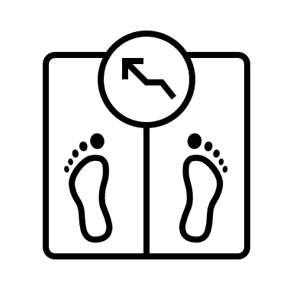

My Page - Overview
Name, age
Weight BMI ???
This week:
M T O T F L S Mål
0 0 0 0 0 0 0 0/3
Weight progression:
90
M T O T F L S
Highlights:
New record – Push ups

Slide 4
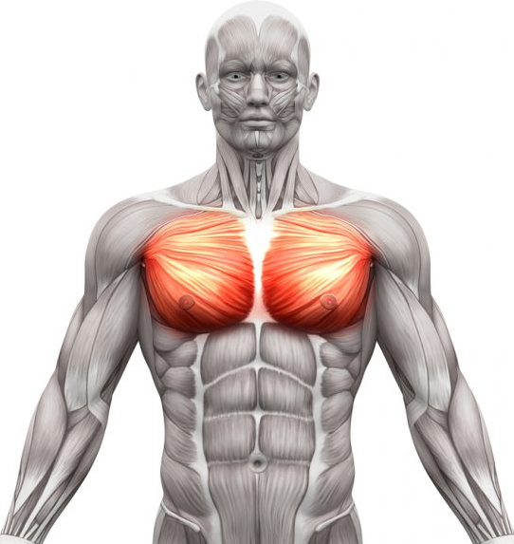
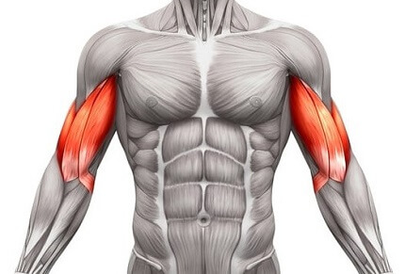
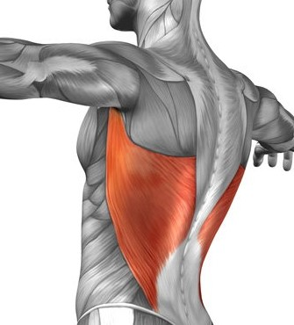
Muscle groups
Bryst
80 %
Biceps
30 %
Lats
55 %
Find exercise with relaxed muscles

Slide 5
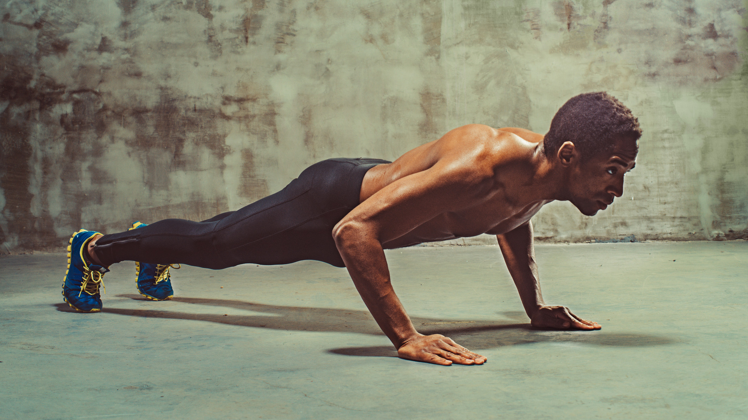
Exercise list
Sugested exercises
Muscle
Equipment
Recomended
Push Up
Muscle:
Chest
Triceps
Abs
3 x 10
Push Up
Muscle:
Chest
Triceps
Abs
3 x 10
Push Up
Muscle:
Chest
Triceps
Abs
3 x 10

Slide 6
Simple Activity
Choose an activity:
Muscles
Equipment
Activity
Back

Slide 7
Simple Activity – Dropdown
Choose an activity:
Muscles
Equipment
Activity
Leg extension
Shoulder press
Fly
Select
Back

Slide 8

Exercise info
Title
Description:
Hold arms out and bend forwards.
This exercise targets:
- Muscle 1
- Muscle 2
Recomended load is:
Sets: 3
Reps: 10
Load: ?
Start exercise

Slide 9
Exercise
Title
Set: n
Do m reps with load k.
Done
Skip
Pause

Slide 10

Relax
Relax
Breathe deeply and Relax.
10
Skip

Slide 11
Pause
Exercise paused
Your exercise was paused.
If you exit the workout now, your progress up til the last exercise will be stored.
Continue
Exit

Slide 12
Exercise Summary
Well done!
You finished your exercise!
You did a total of ... reps with ... kg.
Your exercise is registered and can be seen in the overview.
Home
New Exercise

Slide 13
Information
Bla
bla
bla
Button
Dropdown
10

Slide 14
Bryst
80 %
Biceps
30 %
Lats
55 %
Push Up
Muscle: Chest
Triceps
Abs
3 x 10

